Slide 1
Senior Registration: Urban and Regional Planning
Curriculum control forms

Slide 2
Programmes and online registration
The following programme is offered by the Subject Group Urban and Regional Planning:
Urban and Regional Planning (2FE K01)
For further assistance with online registration procedures, kindly follow this link: http://natural-sciences.nwu.ac.za/senior_registration

Slide 3
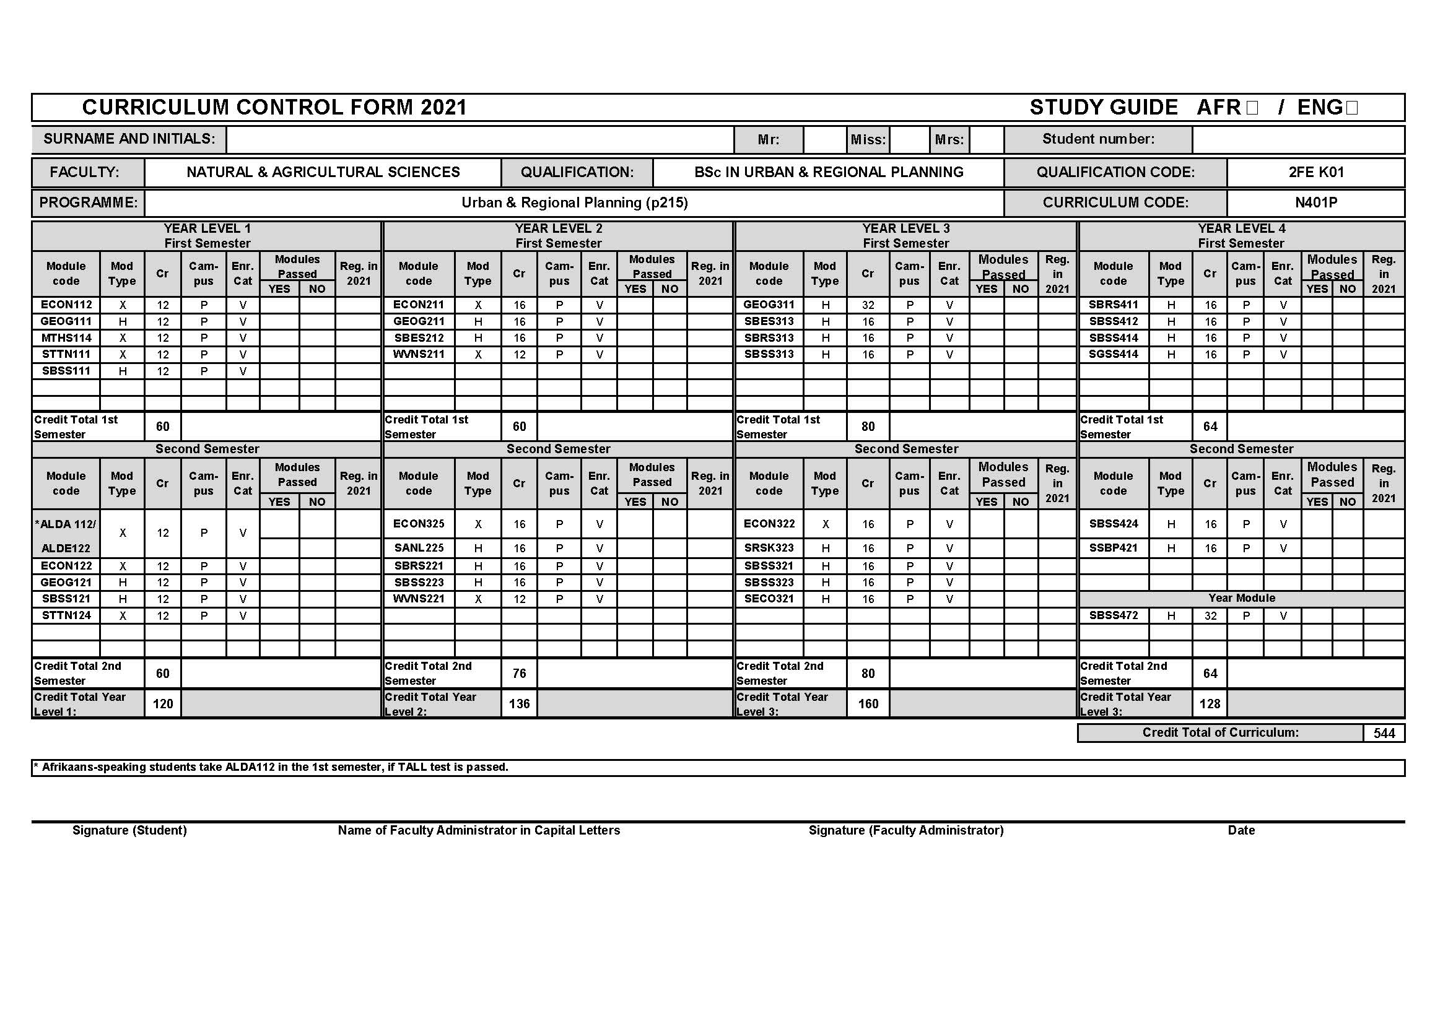
Urban and Regional Planning (2FE K01)

Slide 4
Further assistance (Urban and Regional Planning)
In case you need assistance with:
changes in course of study (different degree),
recognition of substitute modules from previous studies,
adding/dropping modules.
Please attend the live Q & A curriculum control session on 8 Feb 10:30-11:30 by navigating to http://natural-sciences.nwu.ac.za/snr_registration_q%26a_sessions
or contact one of the following persons for advice:
Prof. Ernst Drewes
Subject Advisor (Urban and
Regional Planning)
Ernst.Drewes@nwu.ac.za
Me. Selna Cornelius
Assistant Subject Advisor (Urban and
Regional Planning)
Selna.Cornelius@nwu.ac.za

Slide 5
Further assistance (Urban and Regional Planning)
For help with administrative issues and to obtain the necessary forms, please navigate to http://natural-sciences.nwu.ac.za/senior_registration and follow the instructions under “Students who require assistance to register” or contact:
Adelle Jerling
FNAS Undergraduate Administrator
Adelle.Jerling@nwu.ac.za
018 285 2761
Jeanne-Marie Coetzee
FNAS Administration Assistant
20536577@nwu.ac.za
018 299 2458

Slide 6
SBSS 472 prerequisites
Refer to the 2021 FNAS undergraduate yearbook (p. 107) for the complete list of prerequisites (available online at http://studies.nwu.ac.za/sites/studies.nwu.ac.za/files/files/yearbooks/2021/2021-FNAS-UGv3.pdf )
All modules should be successfully completed to be able to continue with SBSS 472.
Student request forms are available online at http://natural-sciences.nwu.ac.za/senior_registration or may be obtained from:
Adelle Jerling
FNAS Undergraduate Administrator
Adelle.Jerling@nwu.ac.za
018 285 2761
Jeanne-Marie Coetzee
FNAS Administration Assistant
20536577@nwu.ac.za
018 299 2458

Slide 7
Typical registration problems for SSB students
Refer to slide 4 (Further assistance) if you experience problems with any of the following:
Recognition of ALDA/ALDE
Outstanding GEOG 211/311 modules
Previous SSB programme modules with old module codes not recognised as prerequisites for current modules
Outstanding modules for SBSS472 registration

